Slide 1
Interrupt Management
Instructor: Zonghua Gu

Slide 2
Process-Aware Interrupt Scheduling & Accounting
Rich West

Slide 3
Problem of Interrupts
Asynchronous events e.g., from hardware completing I/O requests and timer interrupts…
Affect process/thread scheduling decisions
Typically invoke interrupt handlers at priorities above those of processes/threads
i.e., interrupt scheduling disparate from process/thread scheduling
Time spent handling interrupts impacts the timeliness of RT tasks and their ability to meet deadlines
Overhead of handling an interrupt is charged to the process that is running when the interrupt occurs
Not necessarily the process associated (if any) with the interrupt

Slide 4
Goals
How to properly account for interrupt processing and correctly charge CPU time overheads to correct process, where possible
How to schedule deferrable interrupt handling so that predictable task execution is guaranteed

Slide 5
Linux Int Handling
Interrupt service routines are often split into “top” and “bottom” halves
Idea is to avoid lengthy periods of time in “interrupt context”
Top half executed at time of interrupt but bottom half may be deferred (e.g., to a schedulable thread)

Slide 6
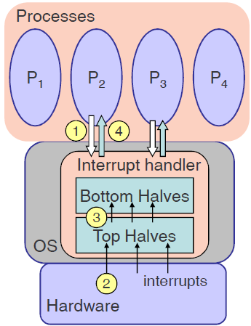
Linux Int Handling
Traditional approach:
(1) I/O service request via kernel
(2) OS sends request to device via driver code; Hardware device responds w/an interrupt, handled by a “top half”
(3) Deferrable “bottom half” completes service for prior interrupt and wakes waiting process(es) – Usually runs w/ interrupts enabled
(4) A woken process can then be scheduled to resume after blocking I/O request

Slide 7
Problems
A real-time or high-priority blocked process waiting on I/O may be unduly delayed by a deferred bottom half
Mismatch between bottom half priority and process
Interrupt handling takes place in context of an arbitrary process
May lead to incorrect CPU time accounting
Why not schedule bottom halves in accordance with priorities of processes affected by their execution?
For fairness and predictability: charge CPU time of interrupt handling to affected process(es), where possible

Slide 8
Process-Aware Interrupt Handling
Not all interrupts associated with specific processes
e.g., timer interrupt to update system clock tick, IPIs…
Not necessarily a problem if we can account for such costs in execution time of tasks e.g., during scheduling
I/O requests via syscalls (e.g., read/write) associate a process with a device that may generate an interrupt
For this class of interrupts we assign process priorities to bottom half (deferrable) interrupt handling
Allow top halves to run immediately, but consider dependency between bottom halves and processes

Slide 9
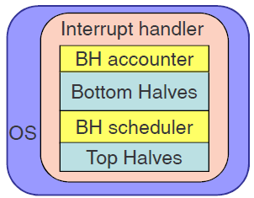
BH Scheduling & Accounting
Modify Linux kernel to include interrupt accounting
TSC (Timestamp Counter) measurements on bottom halves
Determine target process for interrupt processing and update system time accordingly
BH/interrupt scheduler immediately between do_irq() and do_softirq()
Predict target process associated with interrupt and set BH priority accordingly

Slide 10
Interrupt Accounting Algorithm
Measure the average execution time of a bottom half (BH) across multiple BH executions
On x86 use rdtsc since time granularity typically < 1 clock tick
Measure total # interrupts processed and # processed for each process in 1 clock tick
Adjust system CPU time for processes due to mischarged interrupt costs
For simplicity, focus on interrupts for one device type (NIC) but idea applies to all I/O devices

